Slide 1
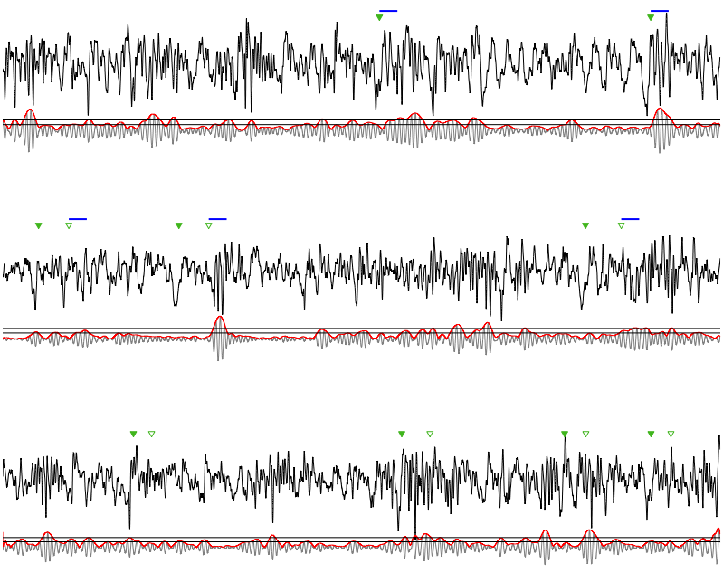
In-phase
raw FRO signal
filtered FRO signal
(7-10 Hz)
Out-of-Phase
No-Stimulation
5 mV
2 s

